Slide 2
Linear Algebra

Slide 3


Intuitive concepts: Linear Algebra
a common approach is to construct a set of objects (symbols) and a set of rules to manipulate these objects. This is known as an algebra.
Linear algebra is the study of vectors and certain algebra rules to manipulate vectors
Denoted as small arrow above the letter:
use a bold letter to represent them
Hints: vectors are special objects that can be added together and multiplied by scalars to produce another object of the same kind. OR a vector as an array of numbers.

Slide 4
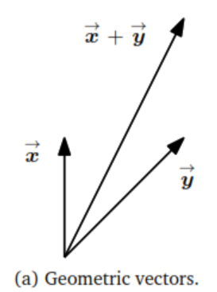
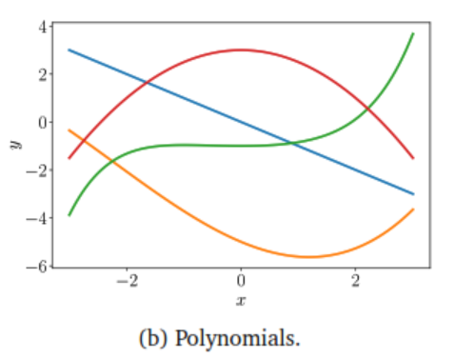
Example 1:
Geometric vector:

Slide 5
Example 2
Audio signals are vectors. Audio signals are represented as a series of numbers. We can add audio signals together, and their sum is a new audio signal. If we scale an audio signal, we also obtain an audio signal. Therefore, audio signals are a type of vector, too.

Slide 6
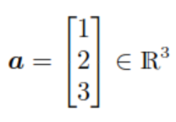

Example 3:
Benefits: Many programming languages support array operations, which allow for convenient implementation of algorithms that involve vector operations.

Slide 7
Vector Space
The concept of a vector space and its properties underlie much of machine learning.
What is the set of vectors that can result by starting with a small set of vectors, and adding them to each other and scaling them?
This results in a vector space

Slide 8
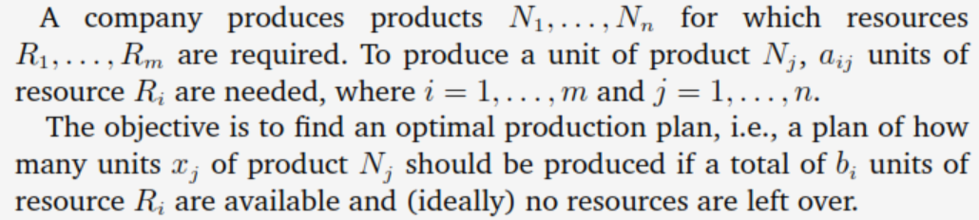
Systems of Linear Equations
Linear algebra gives us a tool “Systems of Linear Equations” for solving many problems which can be formulated as Systems of Linear Equations.
Example:

Slide 9
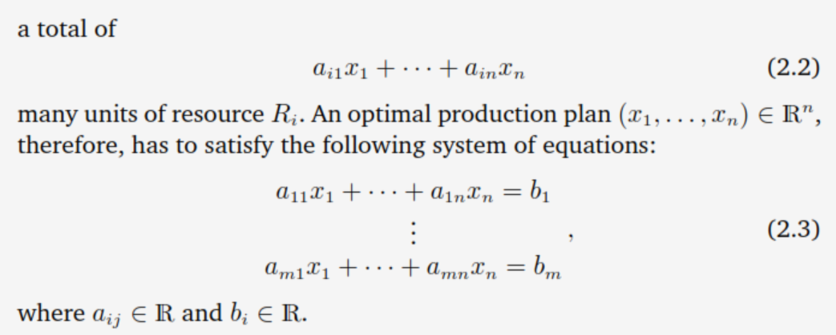
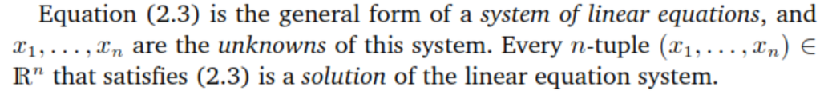
Solution:

